Slide 1

ETHEREUM FRAUD DETECTION
By:
Denesh Kumar [dzm5964@psu.edu]
Aadya Sanwal [afs6594@psu.edu]

Slide 2

APPLICATION OF clustering METHODS
Class Label: FLAG- Fraudulent Transaction (Yes = 1, No = 0)
Explanatory Variables:
Avg min between sent (received) transactions
Time Diff between first and last (Mins)
Total number of sent (received) normal transactions
Total Number of created contract transactions
Total Unique addresses from which account sent (received) transactions
Min/ Max/ Avg value in Ether ever sent (received)
Total Ether Balance following enacted transactions
Total number of ERC20 token transfer transactions….
Overall: 45 numeric explanatory variables; 2 character variables
9841 rows of data
Exploratory Data Analysis
Principal Component Analysis
K-means Clustering
Gaussian Mixture Models
PCA- reducing feature space to 2 dimensions
Re-run K-means and GMM

Slide 3
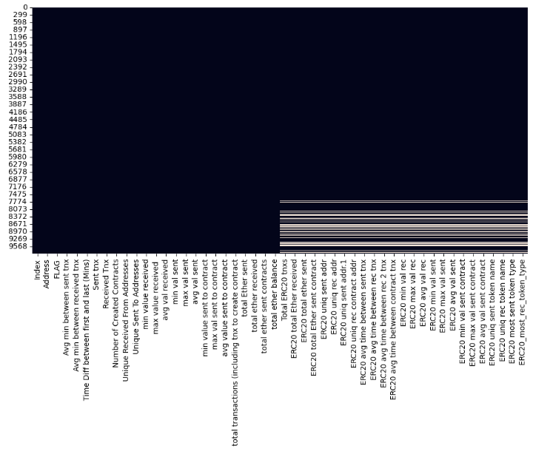
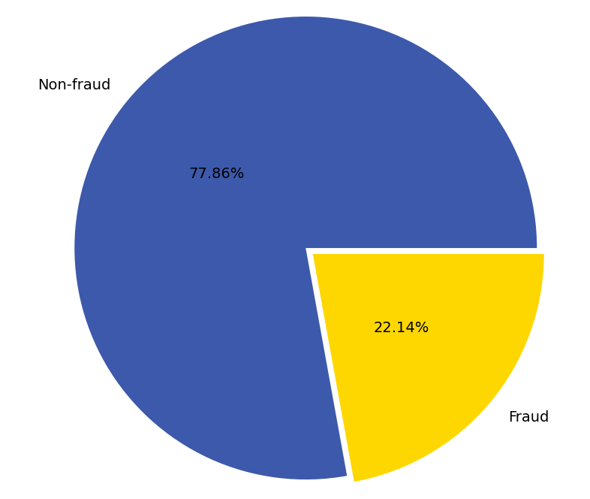
EXPLORATORY DATA ANALYSIS
Imbalanced dataset: 2179 of 9841 observations for fraudulent transactions
Missing observations:

Slide 4
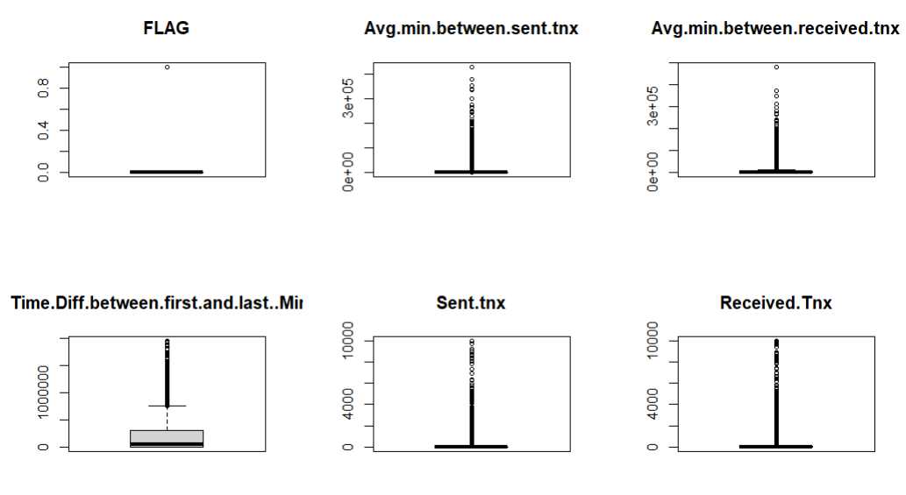
EXPLORATORY DATA ANALYSIS
Key Observation:
Extremely skewed data with maximum predictor values at zero.

Slide 5
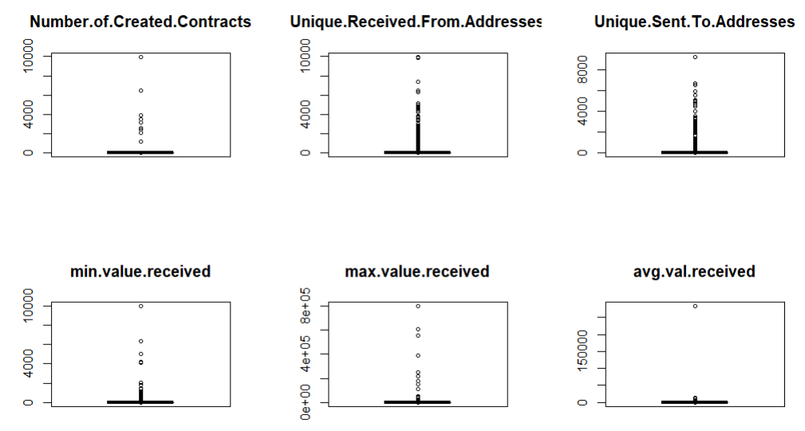
EXPLORATORY DATA ANALYSIS
Key Observation:
Extremely skewed data with maximum predictor values at zero.

Slide 6
Data pre-processing
Key Steps:
Dropping text columns with NAs and high number of unique values
Dropping columns that exhibit zero variance
Removing outliers (> 3 standard deviations away from the mean for each column)
ERC20 most sent token type
ERC20_most_rec_token_type
ERC20 avg time between sent tnx
ERC20 avg time between rec tnx
ERC20 avg time between rec 2 tnx
ERC20 avg time between contract tnx
ERC20 min val sent contract
ERC20 max val sent contract
ERC20 avg val sent contract
total 120 values dropped

Slide 7
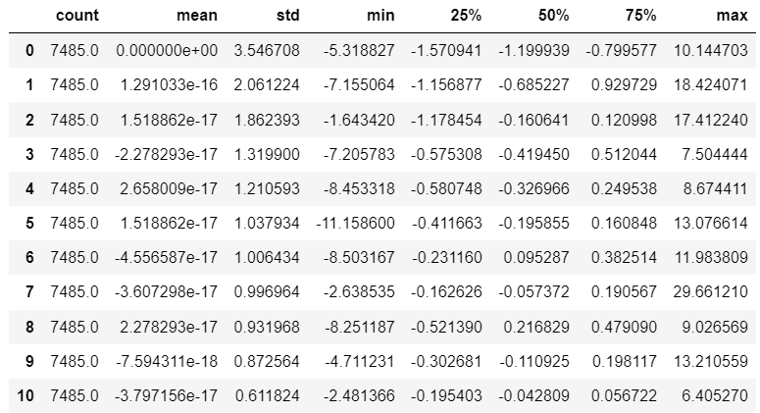
DIMENSION REDUCTION
Normalization: to ensure we can apply clustering methods accurately
PRINCIPAL COMPONENT ANALYSIS
Retaining components that explain 95% of overall
Variance:
Explained Variance:
95.29517312255108% with 11 features

Slide 8

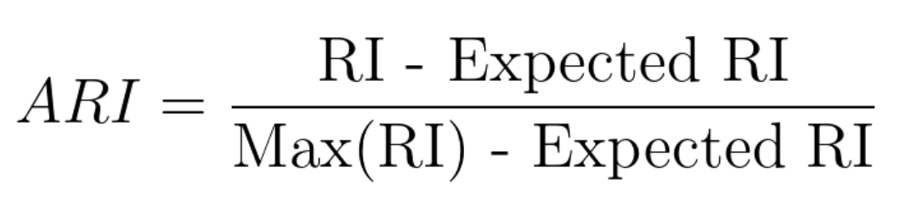
Adjusted rand index
RAND INDEX (RI)
= number of agreeing pairs =
number of pairs
a. # pairs of elements that are in the same subset in X and Y
b. # pairs of elements that are in different subsets in X and Y
c. # pairs of elements that are in the same subset in X and different subsets in Y
d. # pairs of elements that are in different subsets in X and the same subset in Y
ADJUSTED RAND INDEX (ARI)
The RI score is “adjusted for chance” into the ARI score
ARI score ranges from zero to one, with:
0 = random labelling
1= clusters are identical

Slide 9
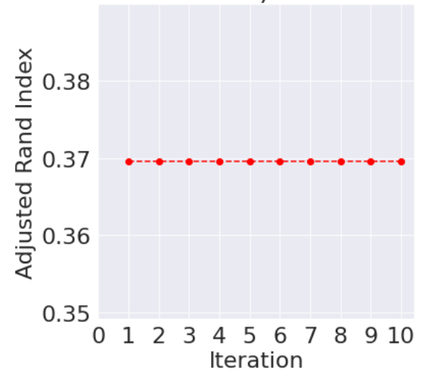
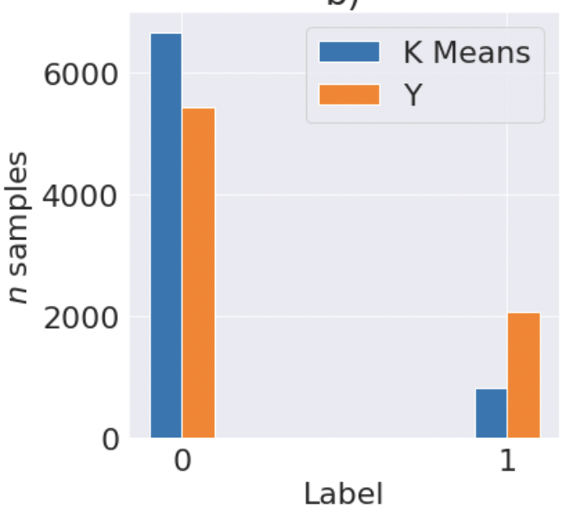
K-means clustering (PCA = 11)
Aims to partition n observations into k clusters in which each observation belongs to the cluster with the nearest mean :
minimizes within-cluster variances (squared Euclidean distances), but not regular Euclidean distances
Rand Index = 0.3695

Slide 10
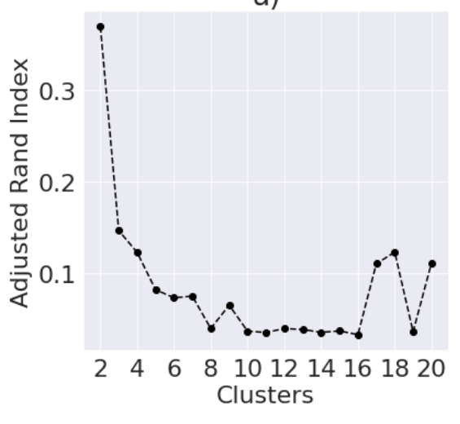
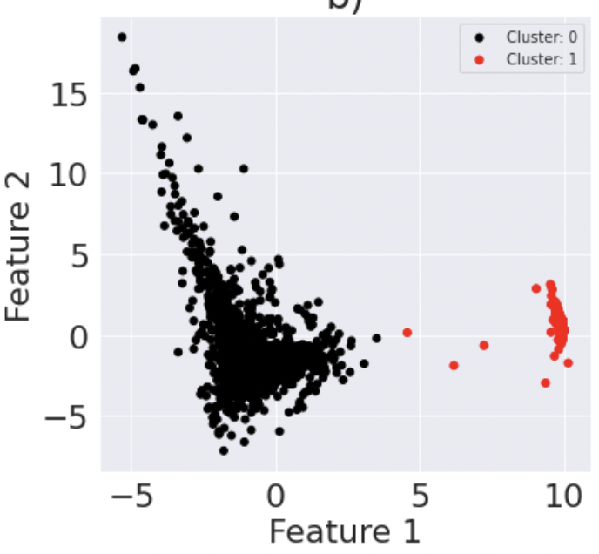
K-means clustering

Slide 11
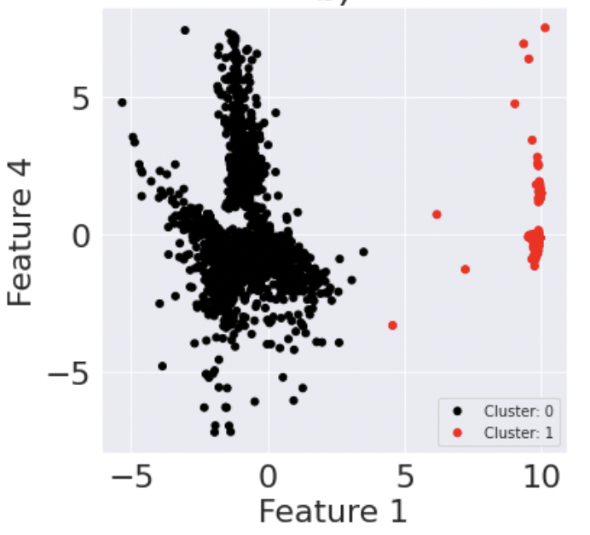
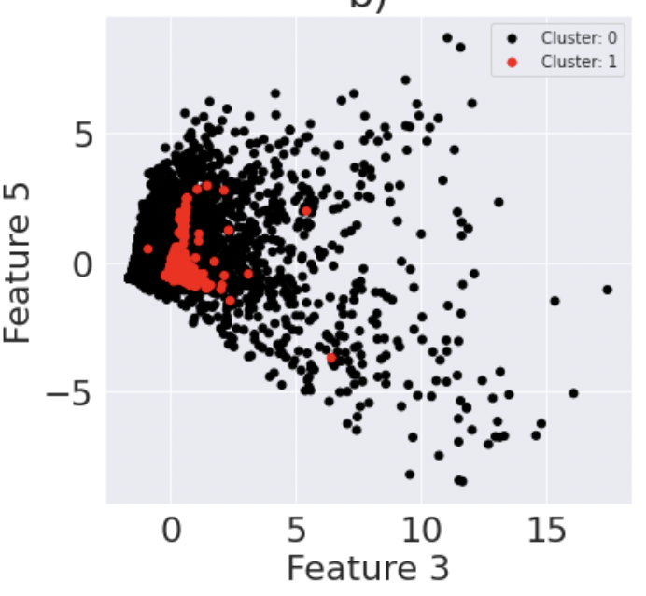

Slide 12
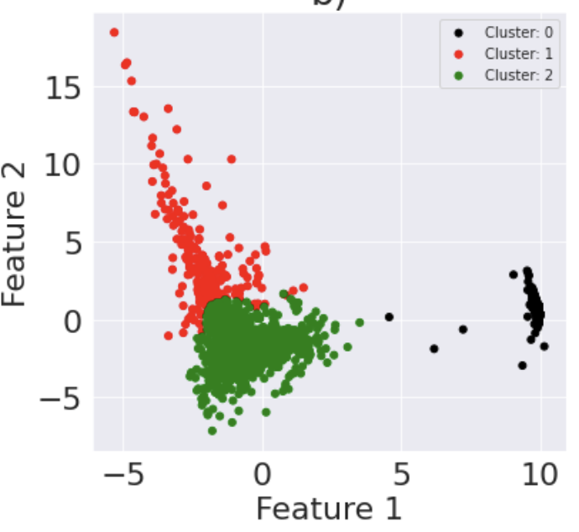
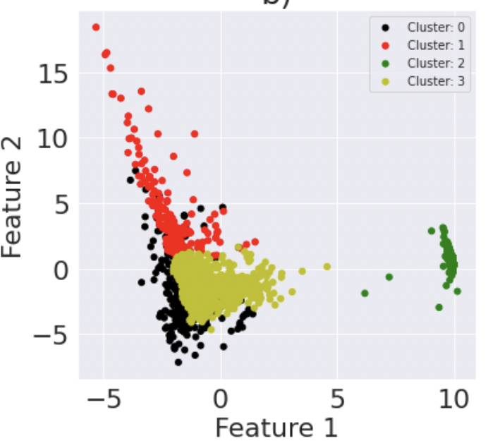
K = 3
K = 4

Slide 13
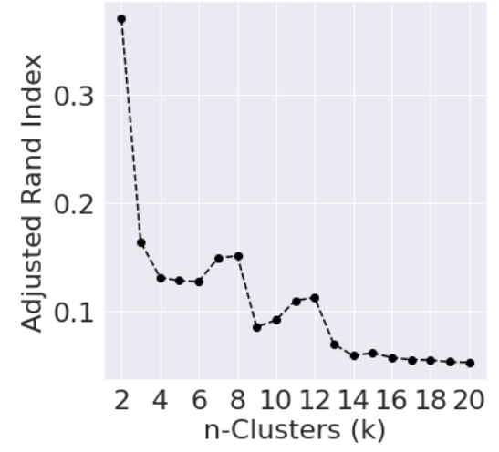
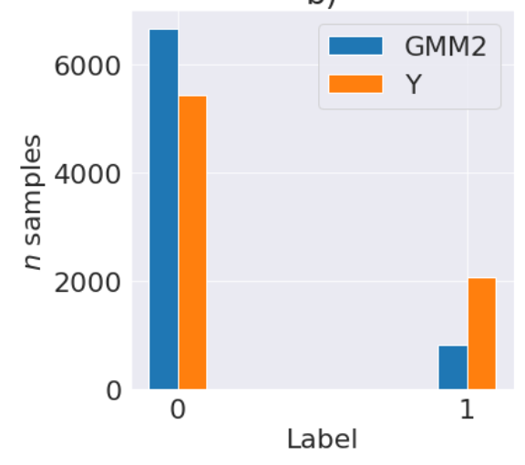
Gaussian mixture model (PCA = 11)
Each cluster is modelled according to a different Gaussian distribution:
flexible and probabilistic approach means that rather than having hard assignments into clusters like k-means, we have soft assignments
Rand Index (K=2) = 0.3695

Slide 14
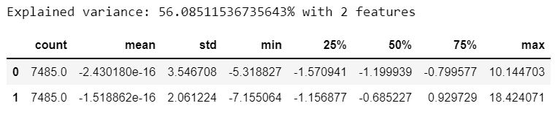
PCA with 2 components

Slide 15
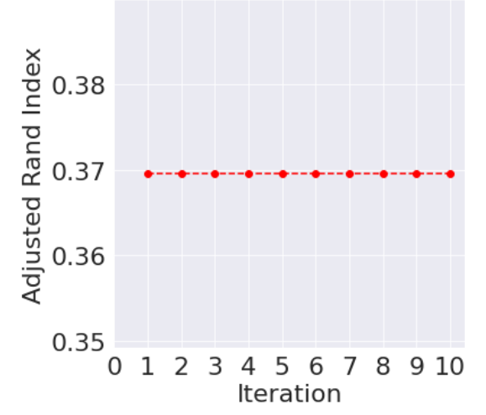
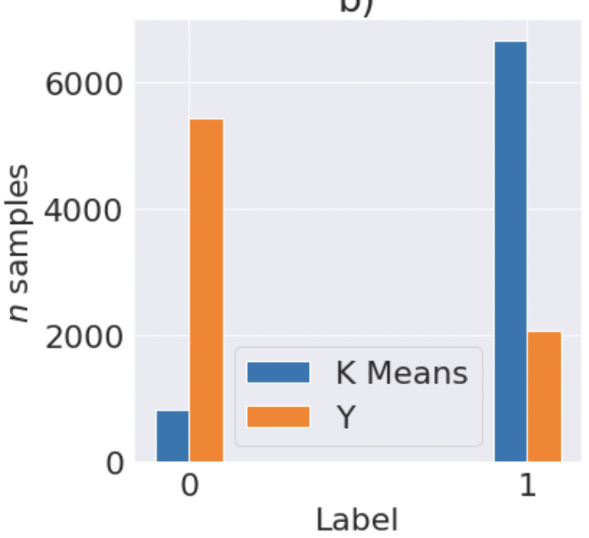
K-means clustering with 2 components
Rand Index = 0.3695

Slide 16
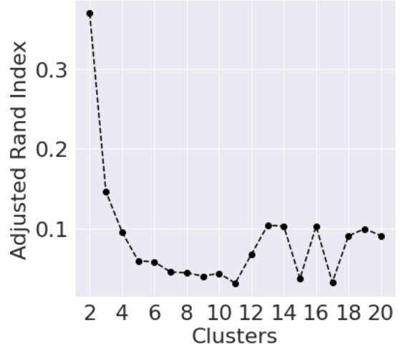
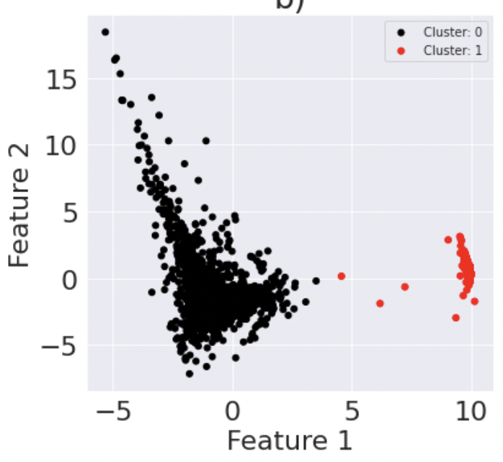
K-means clustering with 2 components

Slide 17
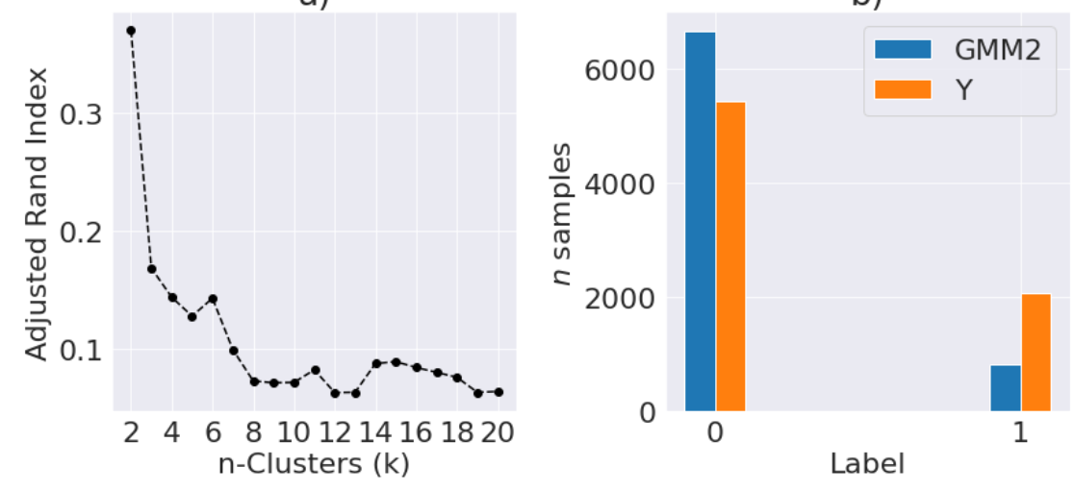
Gaussian mixture model with 2 components
Rand Index = 0.3706

